Slide 1
Introduction to Circuits
Ethan Mathai
Computational Biology Club at UC Davis

Slide 2
Warmup
3 Truths and a Lie

Slide 3
A First Look
What do you think of first when you hear the term “circuit?”

Slide 4
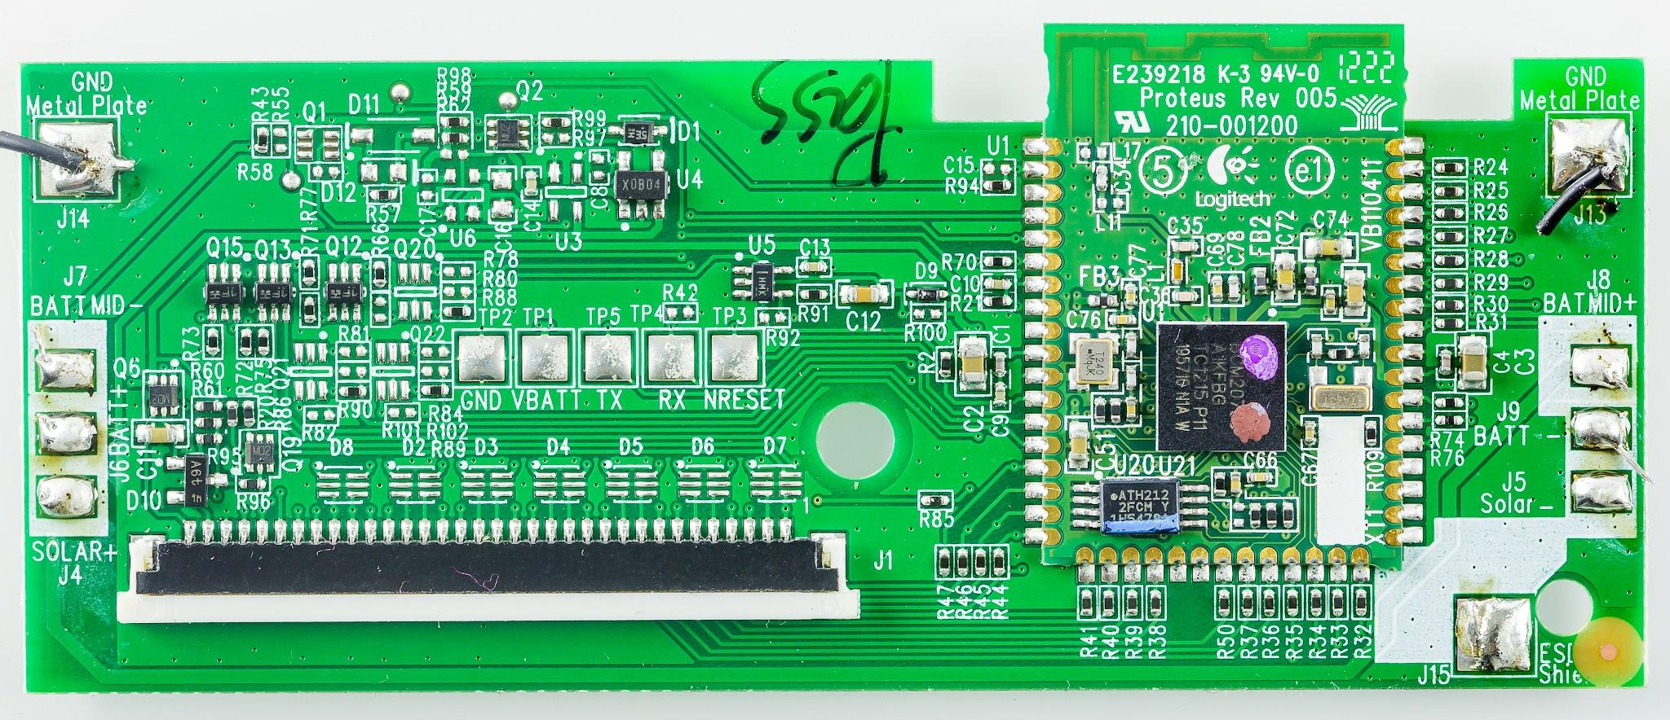


Some Common ideas:

Slide 5
Circuit: a construction of building blocks of controllers for unique and specific systems
Typically, you will observe some kind of “looping” mechanism… This is not necessary, however.

Slide 6
Why Know Circuits?
Extreme precision and detail
Boosted efficiency
Predictable in Performance
Various Applications
Modelling…

Slide 7
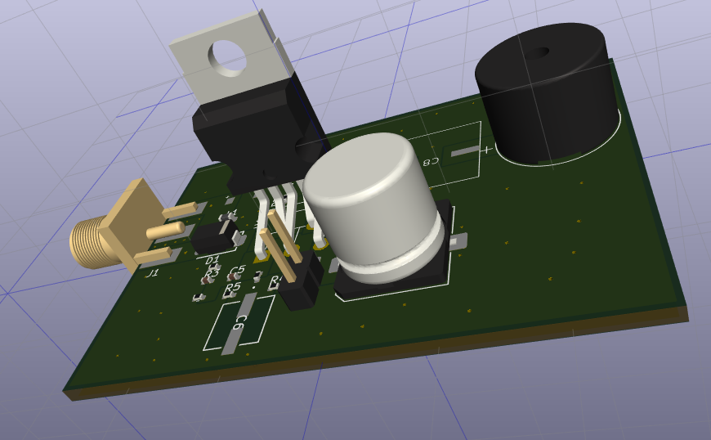
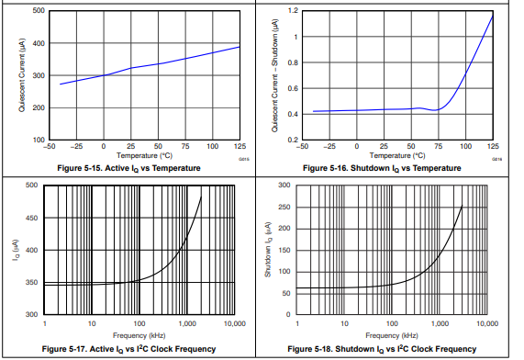
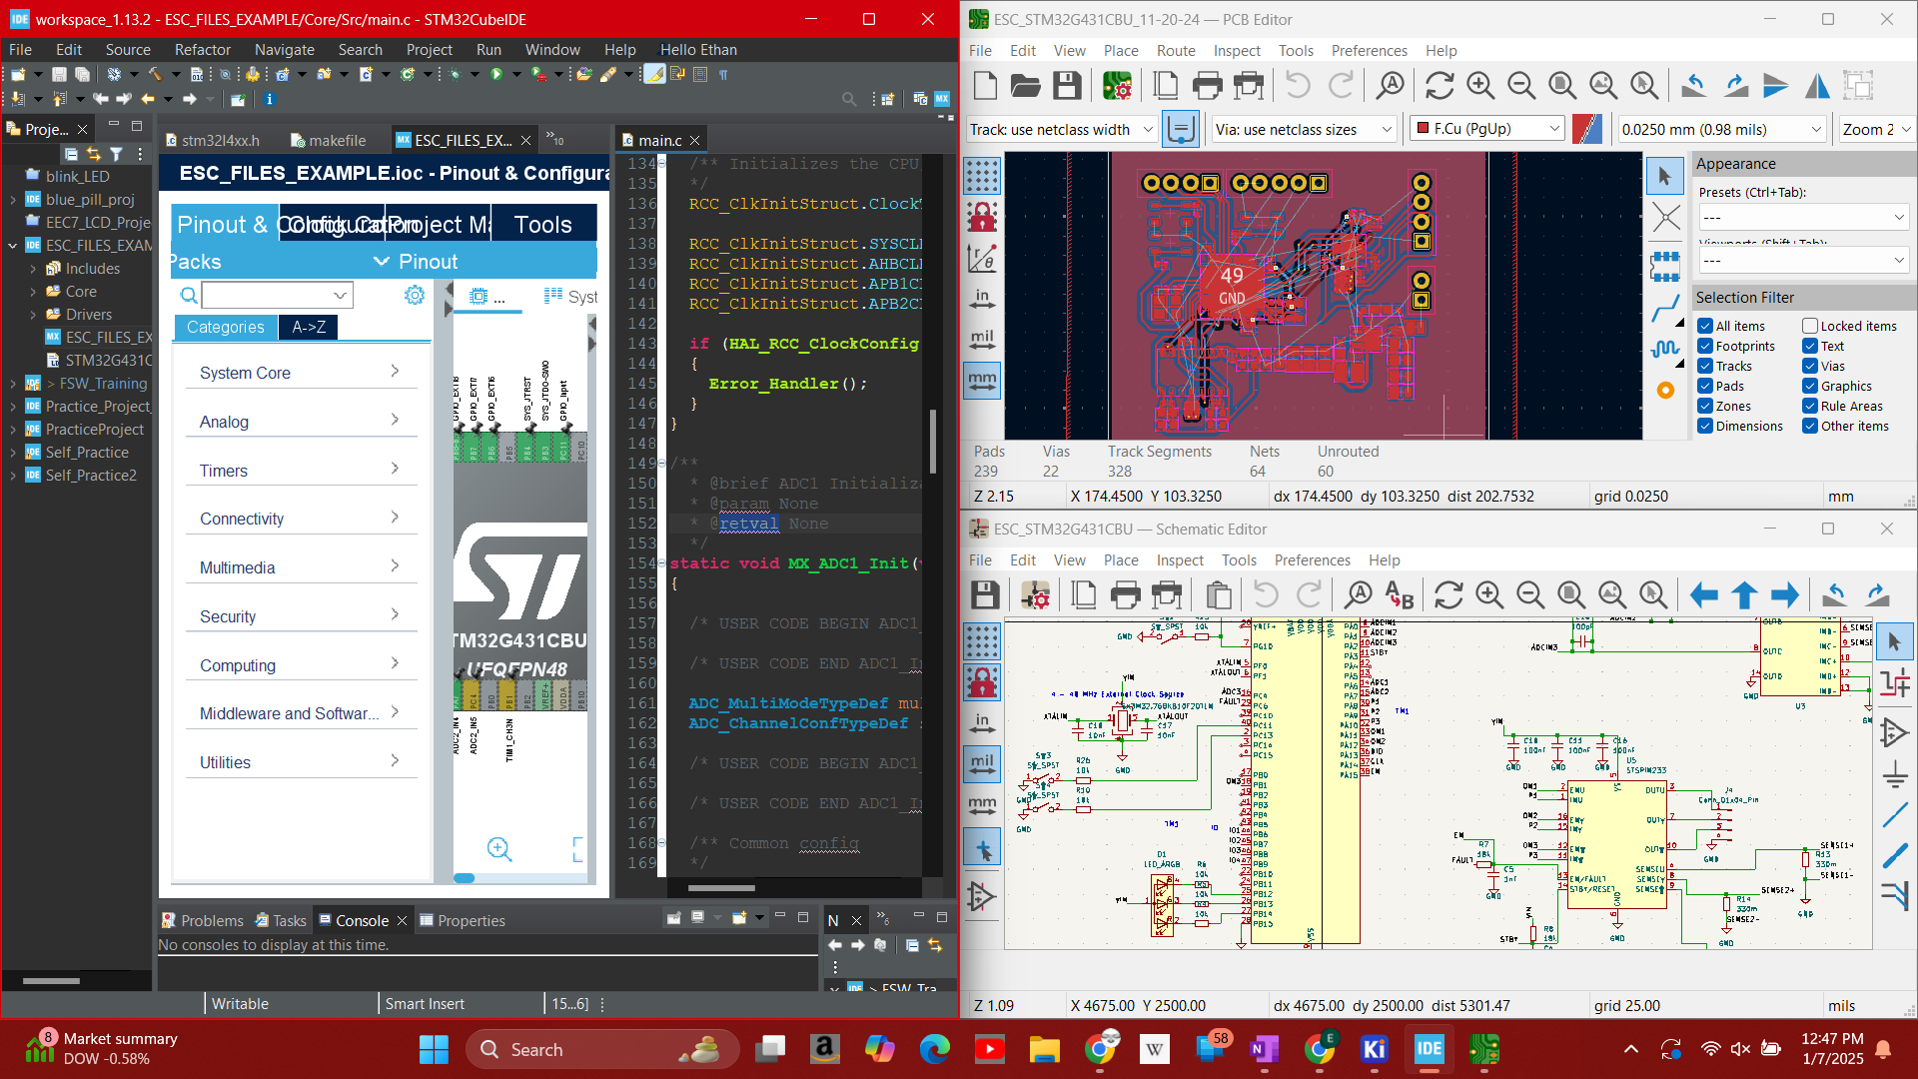
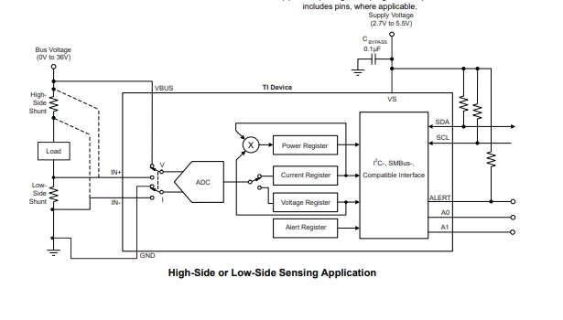
Shameless Plug - some of my Designs + Design Processes (Electronic Circuits)
Notes:
Credits:
Space and Satellite Systems at UC Davis - esc_v2
Ethan Mathai - AM Radio Board
Texas Instruments - 36V, 16-bit, Ultra-Precise I2C Output Current, Voltage, Power Monitor with Alert

Slide 8
Back to Modelling
We can model systems in biology using electronic circuit elements.
Allows us to do math with circuits
Design probabilistic models
Create our own models

Slide 9
Circuit Elements
A comprehensive introduction

Slide 10
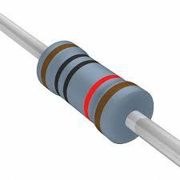
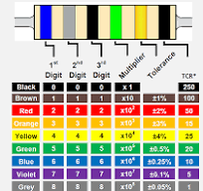
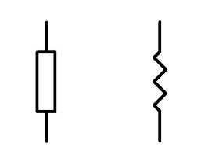
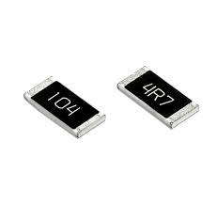
Resistors
[1] [2]
Resistor: Acts as a semi-insulating material due to physical material properties
Measured in Ohms
Dependent on size/material quality
Purposes:
“Creating” current from voltage
Dividing voltages
Limiting current
[3] [4]
Notes:
[1] Through Hole Resistors. Digikey. Accessed: Sept. 18, 2024. (Image) Available: https://www.digikey.com/en/products/detail/yageo/MFR-25FRF52-10K/14626
[2] What are Resistor Color Codes: Insight on Color Bands. TE Connectivity. Accessed: Sept. 18, 2024. (Image) Available: https://www.te.com/en/products/passive-components/resistors/intersection/resistor-color-codes.html
[3] Resistor Basics: Resistor Symbol. What is it used for? Jak Electronics. (Dec. 20, 2019). Accessed: Sept. 18, 2024. (Image) Available: https://www.jakelectronics.com/blog/resistor-basics-resistor-symbol
[4] Surface Mount Resistors, with High Reliability. TE Connectivity. Accessed: Sept. 18, 2024. (Image) Available: https://www.te.com/en/products/passive-components/resistors/surface-mount-resistors.html?tab=pgp-story

Slide 11
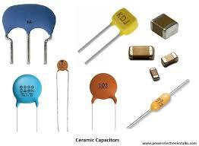
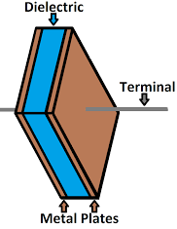
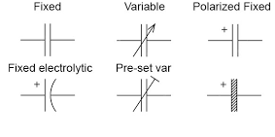
Capacitors
[1]
Can think of these as miniature storage cells that can “discharge” current
Measured in Farads (F)
Will often see incredibly small values, like μF and pF
Types: electrolytic, ceramic, mica, polymer, styrene, tantalum, etc.
Dependent on size/material
Current proportional to change in voltage
Purposes:
Creating oscillation
Filtering signals
Decoupling
Storing energy
[2]
[3]
Notes:
[1] Types of Capacitor. Power Electronics Talks. (Apr. 27, 2024) Accessed: Sept. 18, 2024. (Image) Available: https://www.powerelectronicstalks.com/2020/04/types-of-capacitor.html
[2] Capacitors. WKU PHYS 301. Accessed: Sept. 18, 2024. (Image) Available: http://physics.wku.edu/phys301/notes/rc-circuits/capacitors/
[3] Capacitors - Repair Basics. Repair Wiki. (July 2024) Accessed: Sept. 18, 2024. (Image) Available: https://repair.wiki/w/Capacitors_-_Repair_Basics

Slide 12
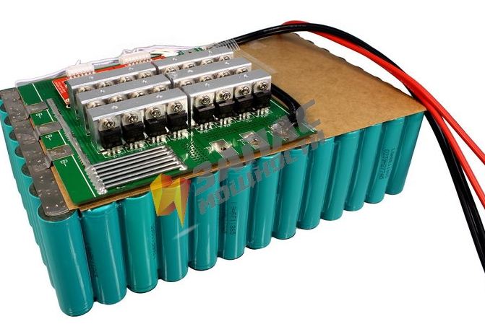
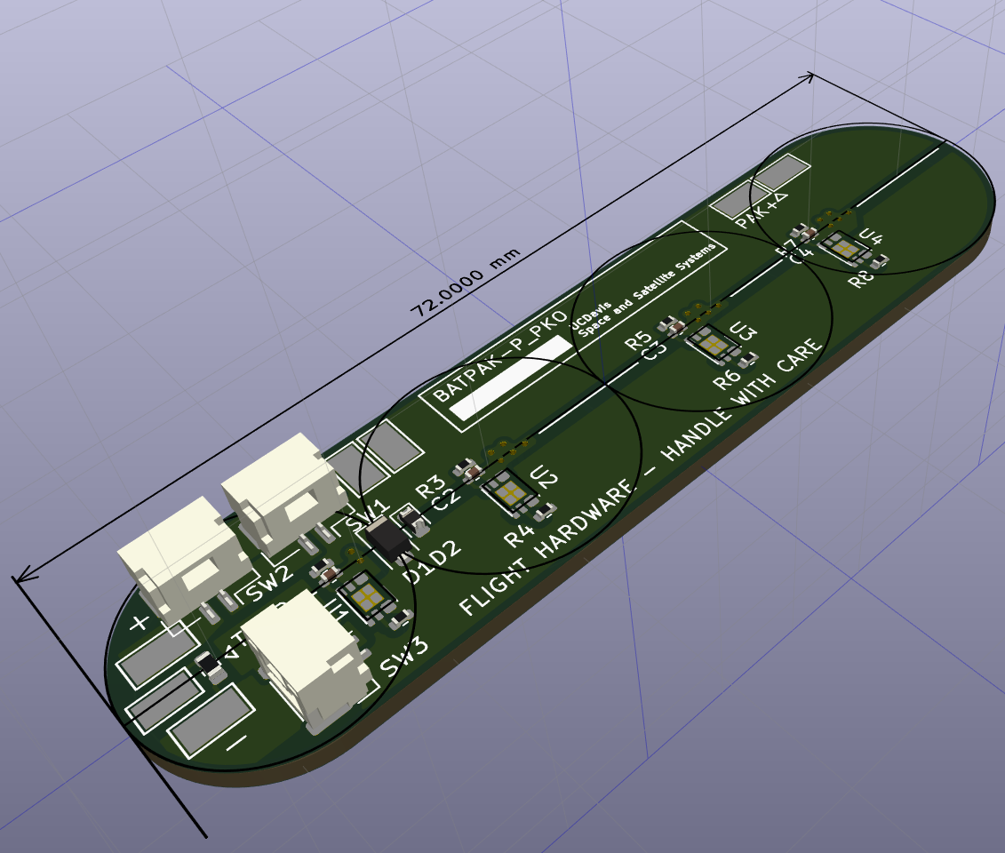
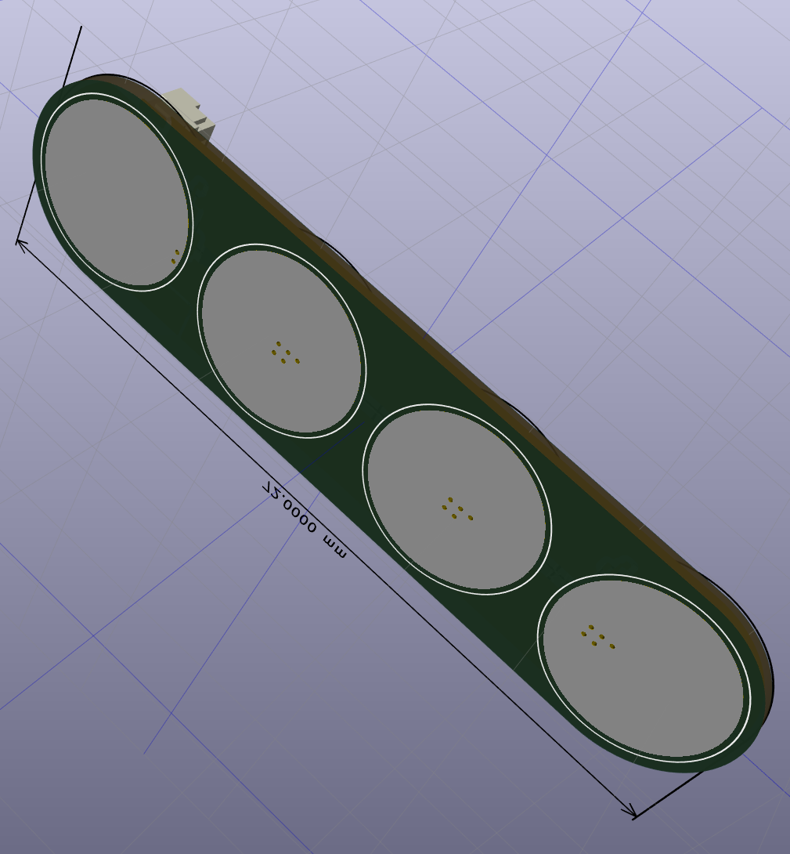
Batteries
Storage containers for energy
Main difference from capacitor: distribute energy over much longer period of time
Ideally, the voltage of a battery shouldn’t change with changing charge
Another key difference is batteries store energy chemically, not with electric fields
Essentially, these provide higher density of storage, making them reliable sources of energy (for our purposes)
Because of energy characteristics, we often talk about energy of battery in Watt Hours (Wh)
[1]
Courtesy of Tim S.
Notes:
[1] batteries - Lithium ion battery how to connect to PCB? Electrical Engineering Stack Exchange. (January, 2019) Accessed: Sept. 20, 2024. (Image) Available: https://electronics.stackexchange.com/questions/418034/lithium-ion-battery-how-to-connect-to-pcb

Slide 13
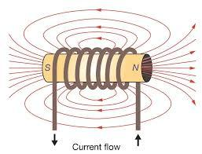
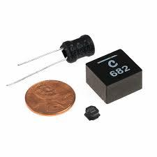
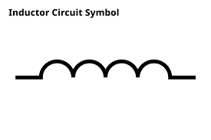
Inductors
[1]
Conductive material that stores energy in a magnetic field when current runs through it
Once current runs through it, wants to keep current running through it
Cannot cut off the current from these devices
Purposes:
Filtering
Storing energy
[2]
[3]
Notes:
[1] Everything You Need to Know About Inductance. School of PE. (Dec. 18, 2023) Accessed: Sept. 18, 2024. (Image) Available: https://www.schoolofpe.com/blog/2023/12/exploring-electromagnetic-inductance.html
[2] How Do Inductors Work. RS. (June 12 2023) Accessed: Sept. 18, 2024. (Image) Available: https://uk.rs-online.com/web/content/discovery/ideas-and-advice/inductors-guide

Slide 14
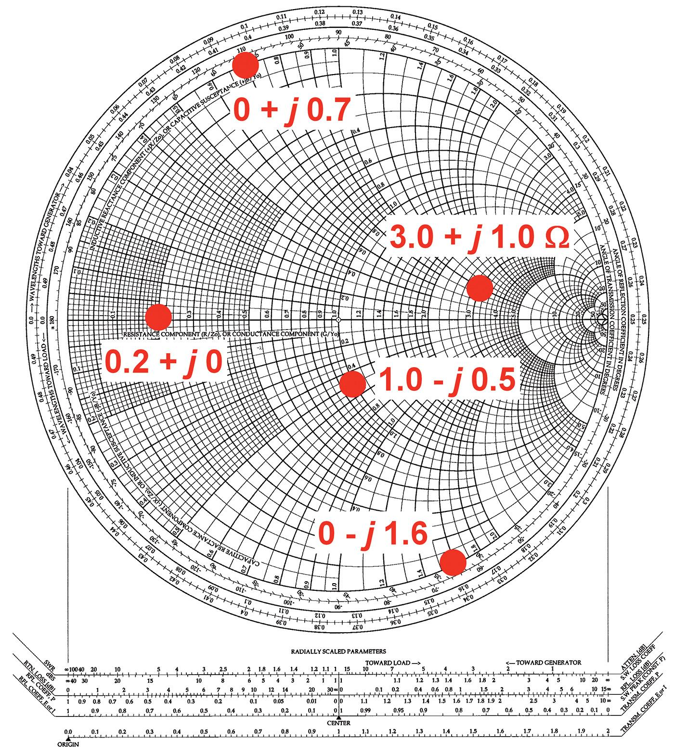
Impedance
This is like a “net resistance” calculation; summation of every element in the circuit that is “impeding” the signal. There is a constant part (represented in Real dimension) and frequency dependent part (Imaginary dimension)
[1]
Notes:
[1] The Smith Chart. Nuts & Volts Magazine. (March 12 2021) Accessed: Sept. 18, 2024. (Image) Available: https://www.nutsvolts.com/magazine/article/the-smith-chart

Slide 15
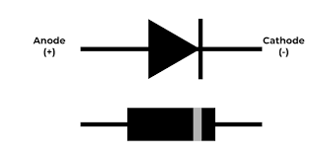
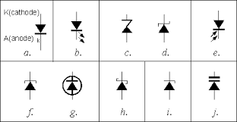
Diodes
[1]
One way switch; once a threshold input voltage is reached, the valve opens
Many types:
General: all purpose diodes
Zener: allow current to flow in reverse
Schottky: lower forward voltage, while still being slightly leaky
LED: Light Emitting Diode
Many more…
Purposes:
Clipping signals (sort of like filtering)
Rectification
Allowing some kind of internal logic
[2]
Notes:
[1] What is Diode - Definition, Types of Diode, V-I Characteristics & Application. GeeksForGeeks. (July 30 2024) https://www.geeksforgeeks.org/diode/
[2] Diodes. Mati David. Accessed: Sept. 18, 2024. (Image) Available: https://www.matidavid.com/electronic_components/05.htm

Slide 16
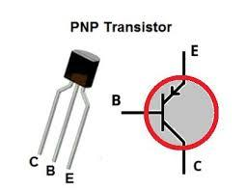
Transistors
Semiconductor devices where you allow current to flow by applying a second current/voltage
BJT (Bipolar Junction Transistor): current controlled
FET (Field Effect Transistor): voltage controlled
Purposes:
Logic controllers
Switches
Amplification
[1]
Notes:
[1] PNP Transistor. GeeksForGeeks. (Oct 17 2021) Accessed: Sept. 18, 2024. (Image) Available: https://www.geeksforgeeks.org/pnp-transistor/

Slide 17
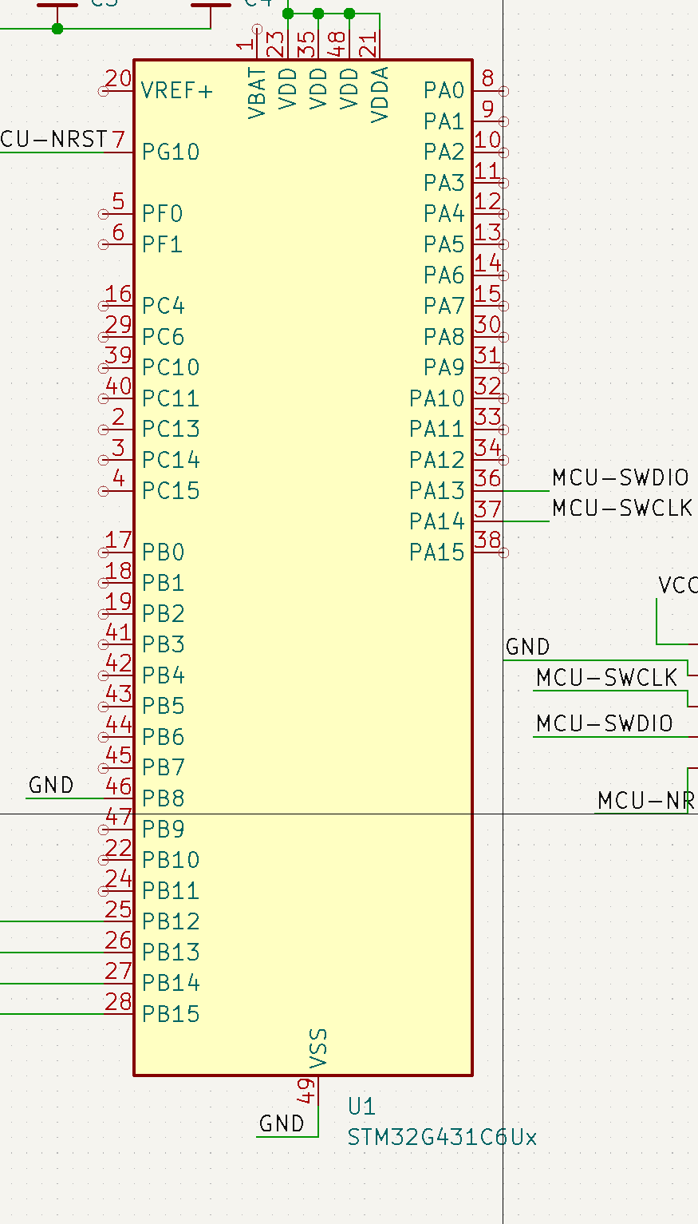
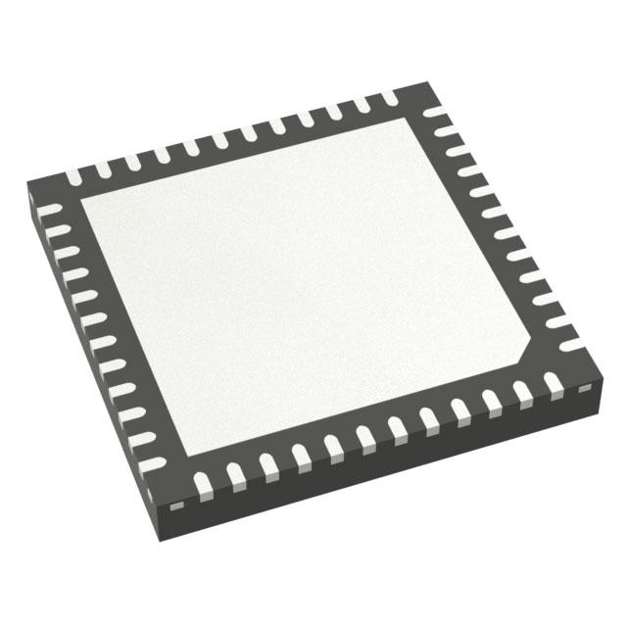
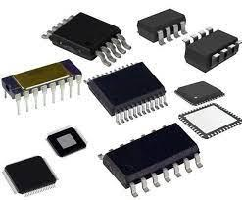
Integrated Circuits (ICs)
Combines components shown before to make miniature circuits that can perform tasks
Various number of ports/sizes/shapes
Types:
Microprocessor
Logic gate
Motor driver
etc.
[1]
[2]
Notes:
[1] STM32G431CBU6. DigiKey..Accessed: Sept. 18, 2024. (Image) Available: https://www.digikey.com/en/products/detail/stmicroelectronics/STM32G431CBU6/10231569
[2] IC Components, For Electronics at Rs 500/piece in Pune. IndiaMart. Accessed: Sept. 18, 2024. (Image) Available: https://www.indiamart.com/proddetail/ic-components-11695046297.html

Slide 18
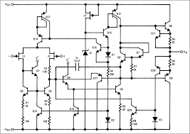
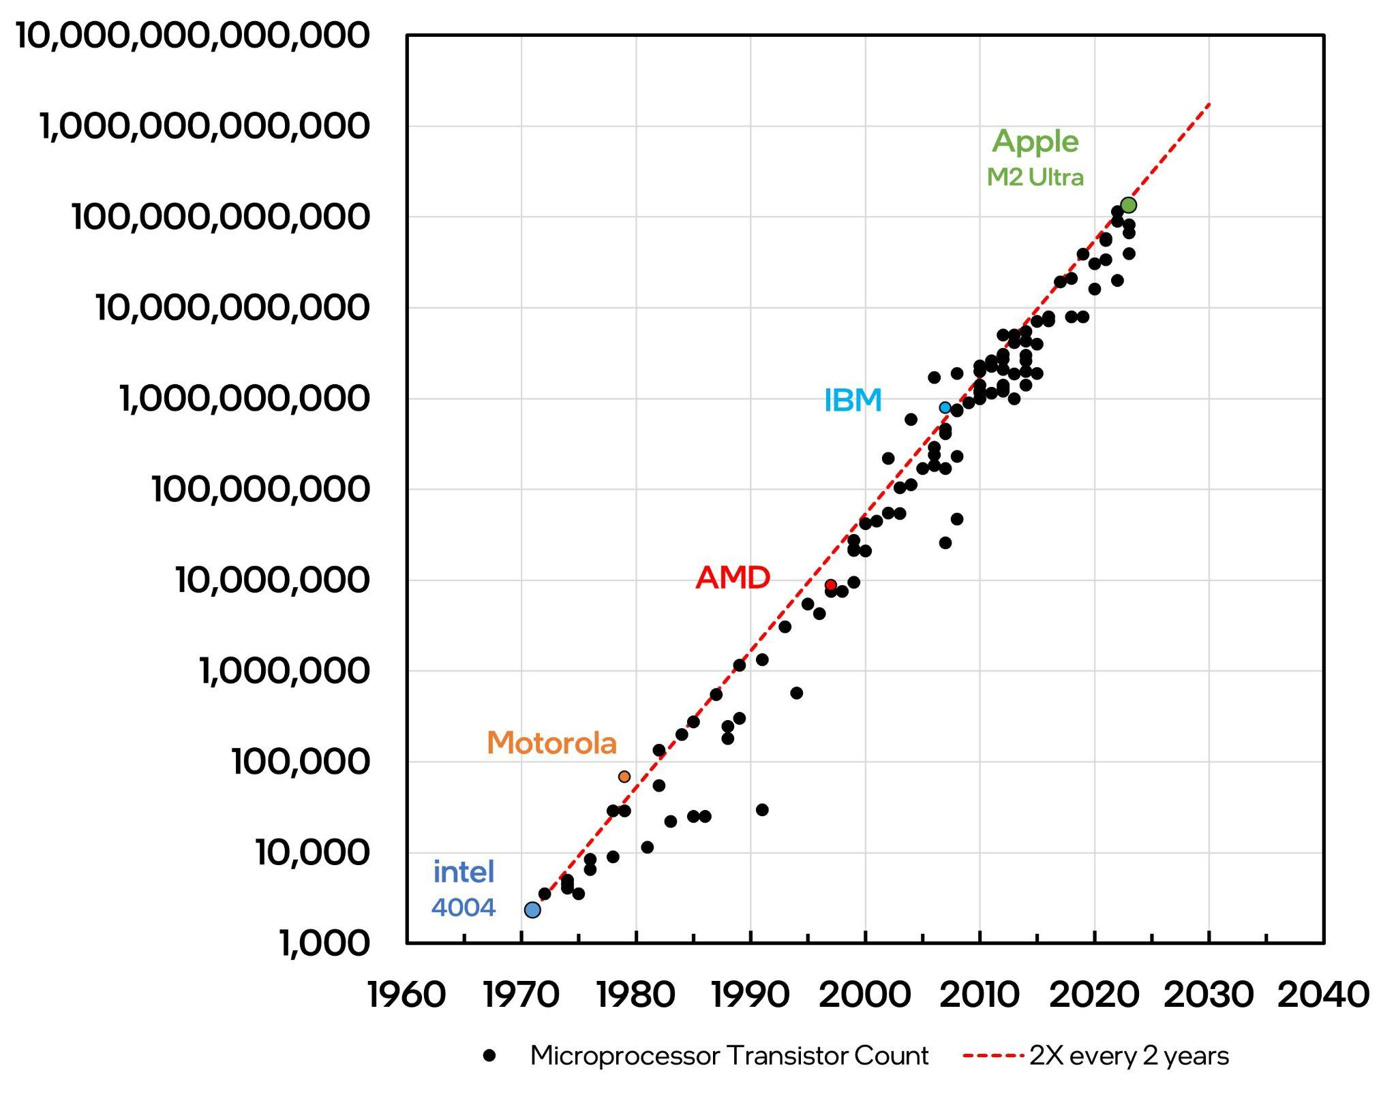
More on ICs
Often, we treat IC’s as “black boxes;” however, they have incredibly complex internal structure.
Moore’s Law
[1]
[2]
Notes:
[1] Integrated Circuits. Basic Car Audio Electronics..Accessed: Sept. 18, 2024. (Image) Available:https://bcae1.com/intcirct.htm#google_vignette
[2] The Relentless Pursuit of Moore’s Law. Semiconductor Substack. (July 16 2023) Accessed: Sept. 18, 2024. (Image) Available: https://semiconductor.substack.com/p/the-relentless-pursuit-of-moores

Slide 19
Circuit Logic

Slide 20
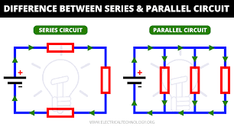
Preliminary Component Configurations
decides how information is relayed
https://www.electricaltechnology.org/2020/05/difference-between-series-parallel-circuit.html

Slide 21
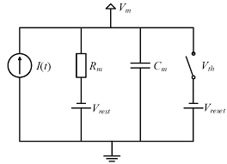
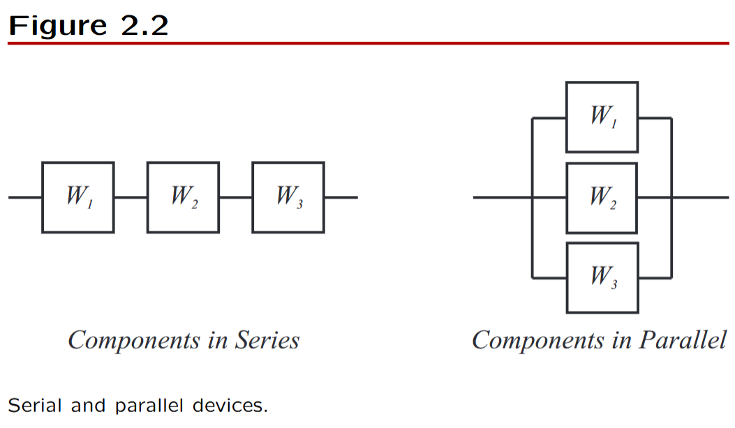
Not Just in Electronics!
Source: Dr. Yubei Chen: Chapter 2 Lecture Notes - Sequential Experiments
LIF Model of Neuron: https://www.researchgate.net/figure/Equivalent-circuit-of-LIF-neuron-model-29_fig1_352422411

Slide 22
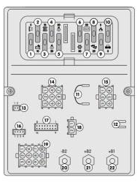
Logic Circuits
Up till now, we have discussed components; now, we can take abstract representations of circuits and start designing logic models.

Slide 23
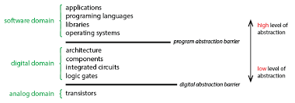
Logic Circuits
Why do we care?
Answer: Abstraction!

Slide 24
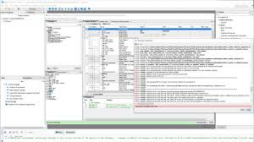
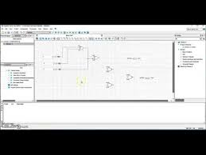
Applied Example: FPGAs (Field Programmable Gate Arrays)
https://community.intel.com/t5/Intel-Quartus-Prime-Software/Compilation-Error-on-Quartus-20-1-Lite/m-p/1298064
Learn More

Slide 25
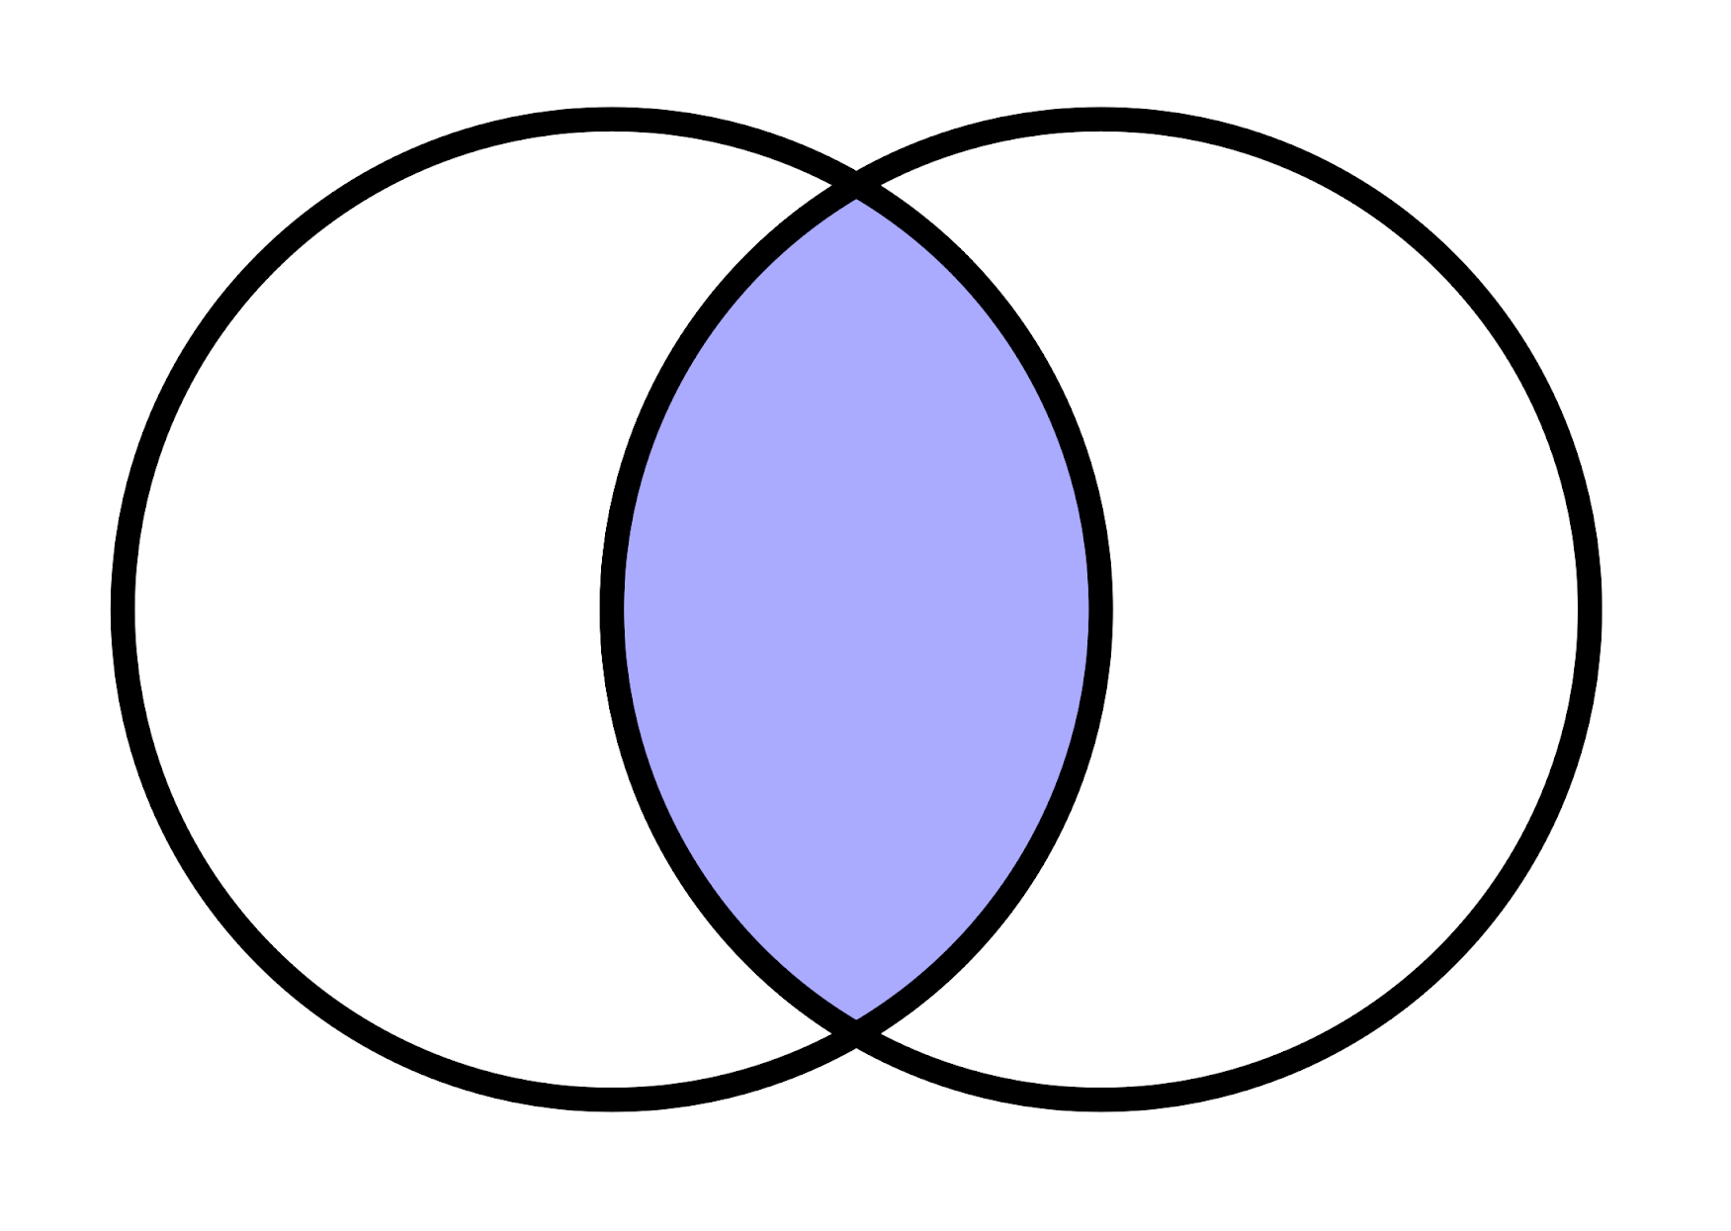
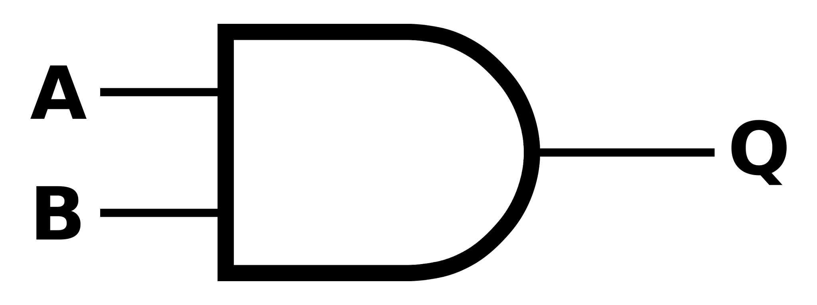
Logical NOT
Logical AND
This is the intersection of two sample spaces (NOTE two sided input)
Symbols: &, ^, .

Slide 26
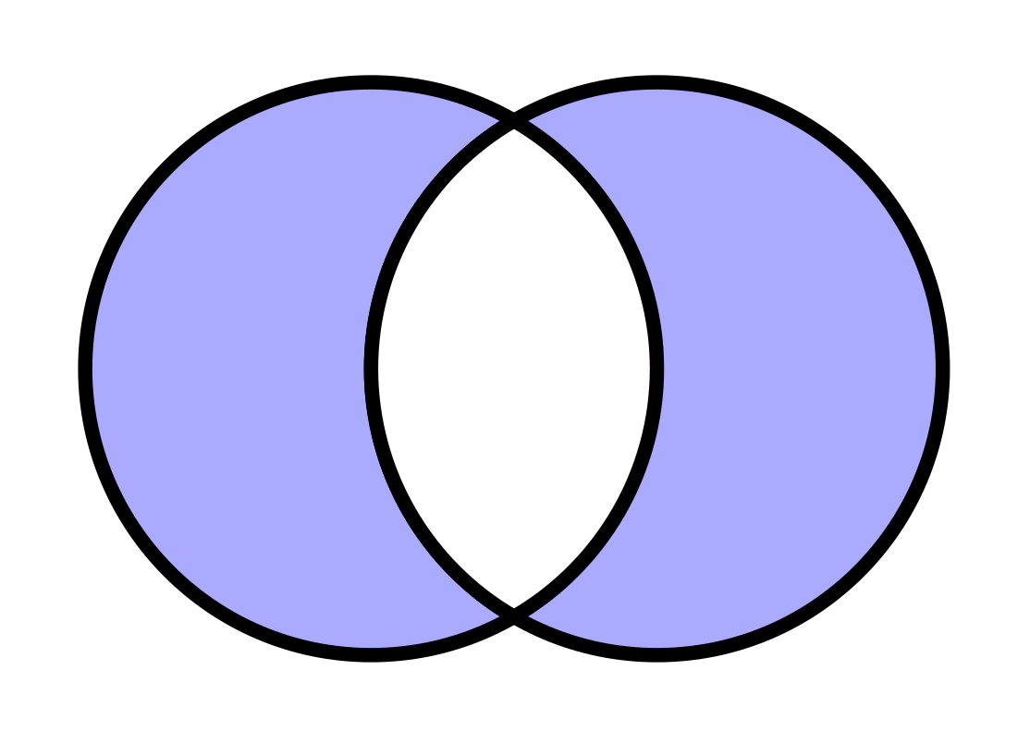
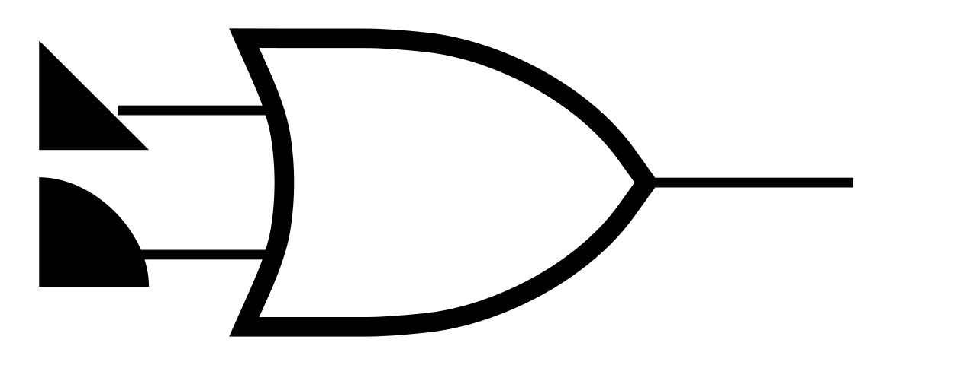
Logical NOT
Logical OR
This is the union of two sample spaces ( WITHOUT the intersection (NOTE two sided input)

Slide 27
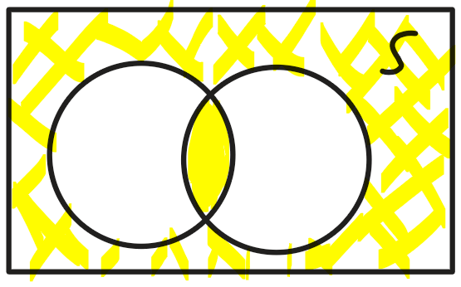
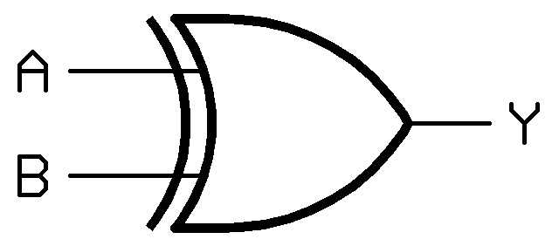
Logical NOT
Logical XOR
This is the complement of a logical OR; returns “true” when both inputs are NOT the same

Slide 28
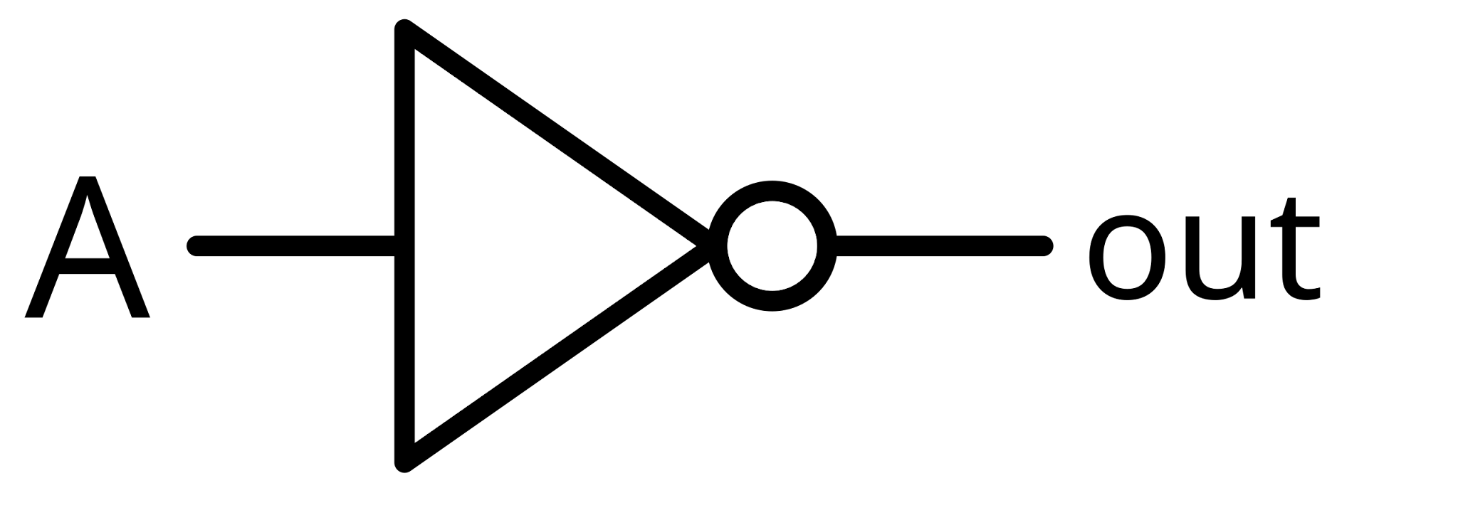
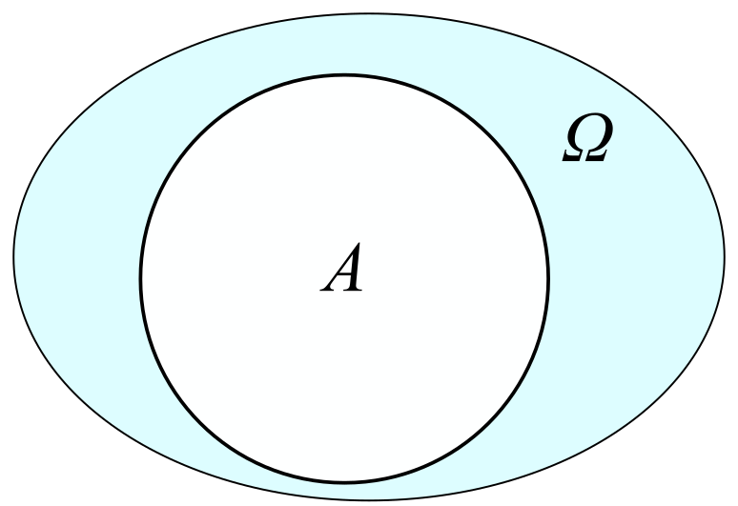
Logical NOT
Inverting
Logical NOT
This is the complement of a sample space
NOTE: if you see that small circle on anything, it indicates that you invert the logic in some way.

Slide 29
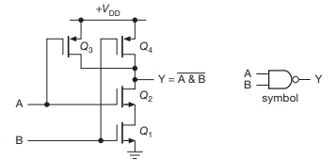
Just to Remind you…
The logic gates themselves are much more “complicated”
CMOSFET: “Complementary Metal-Oxide Silicon Field Effect Transistor”

Slide 30
Logic Diagrams
Now we have some (high level) buiilding blocks that we can at least start to learn how to work with…

